Slide 1

Fundamentals of Computer Network Organization and Architecture

Slide 2
Group Members and Roles
Cabaas Abdulkadir
Joselyn Fear (She/Her): Historical Highlights, Link Layer, Session Layer, Application Layer
Sasha Johnson: Packet Fragmentation / Reassembly, Control Flow
John Olson: IP Addresses including IPv4 vs IPv6, DNS Protocol, DHCP, and TCP/IP/Ethernet Layered Structure vs OSI Model (with Cabaas)
Kenny Pham

Slide 3
Presentation Overview
Historical Highlights that Influenced Computer Network Architecture and Organization
Layered Network Communication Structure and the OSI Model
Physical Structure of a Computer Network
Data Link Layer
Network Layer: Internet Protocol
Transport Protocols: Transmission Control Protocol, User Datagram Protocol and QUIC
Session Protocols: SSL /TCL
Presentation Layer: Multipurpose Internet Mail Extensions (MIME)
Common Application-Level Protocols: Hypertext Transfer Protocol (HTTP), File Transfer Protocol (FTP), Mail Protocols (SMTP, POP, and IMAP)
Some Examples (Wireshark Analyzer Captures)

Slide 4
Historical Highlights that Influenced Network Architecture
Early data networks relied on pre-existing telephone communication infrastructure. The Bell 101 (1958) was the first commercially available MODEM and among its first uses was the networking of a US Military RADAR system. Data transfer speed of ~100baud
Among the first non-government computer networks was the commercial airline reservation system (1960), which connected two mainframe computers.
Local Area Networks began to be installed in the 1960s at institutions like the National Physical Laboratory (UK) using dedicated lines. Data transfer speeds of ~800Kbaud

Slide 5
Historical Highlights that Influenced Network Architecture
In 1969, the first four nodes of ARPANET were connected between UCLA, Stanford, UC–Santa Barbara, and the University of Utah. Transfer speeds of ~50Kbaud
In 1972, the first commercial public data networks were deployed in Europe.
In 1973, Ethernet is developed at Xerox PARC, based on previous work done at the University of Hawaii. Patents are issued for related technologies in 1977 and 1978. Initial data transfer ~3 Mbaud
The Transmission Control Protocol is officially specified in 1974, and the term Internet is coined.
The first long-distance fiber network is deployed in 1977 in California.
Ethernet is made an open rather than proprietary standard in 1979 and by 1980 data transfer rates are upgraded to ~10 Mbaud.

Slide 6
Historical Data Transfer Rates
Year | Approximate Data Transfer Rate Available
1958 | ~110 b/s
1960s (LAN) | ~768,000 b/s – 1,544,000 b/s
1969 (Internet) | ~50,000 b/s
1973 (Ethernet) | ~3,000,000 b/s
1980 (Ethernet) | ~10,000,000 b/s
1995 (Ethernet) | ~100,000,000 b/s
1998 (Ethernet) | ~1,000,000,000 b/s
2018 (Ethernet) | ~400,000,000,000 b/s

Slide 7
History: Advanced Research Projects Agency Network (ARPANET)
Established under the auspices of the US Department of Defense.
The initial intent was to allow resource (mainly information) sharing between sites.
Research at DARPA and in Europe led to the idea of connecting multiple local networks into a larger Internetwork. TCP/IP was installed on ARPANET in 1983 after the US Department of Defense decided to make that suite the standard for its military computing networks.
ARPANET was expanded during the 1980s by the National Science Foundation. Selected Universities hosted national supercomputing centers to provide network Interconnectivity.
In 1990, ARPANET was formally decommissioned and commercial interests were made primarily responsible for the Internet.

Slide 8
Internet Communication Structure
Overview:
Different Local Area Networks (LANs) may have different architectures, but these are to be abstracted behind a common Internetwork Protocol.
Individual hosts are responsible for reliability, not the Network-as-a-Whole. The Network was only responsible for providing a reliable byte stream, not a datagram (Header/Body payload)
A layered-approach, where lower-level implementations were abstracted away from higher-level applications was preferred.
Interior/intermediate nodes were only responsible for relaying the byte stream. All processing was to only occur at the source (before transfer) or destination (after transfer). As such, as long as a byte stream can be transferred, the hardware medium is unimportant/irrelevant.
Robustness: when sending information, care should be taken that the datagram is well-formed. When receiving information, any intelligible datagram should be accepted.

Slide 9
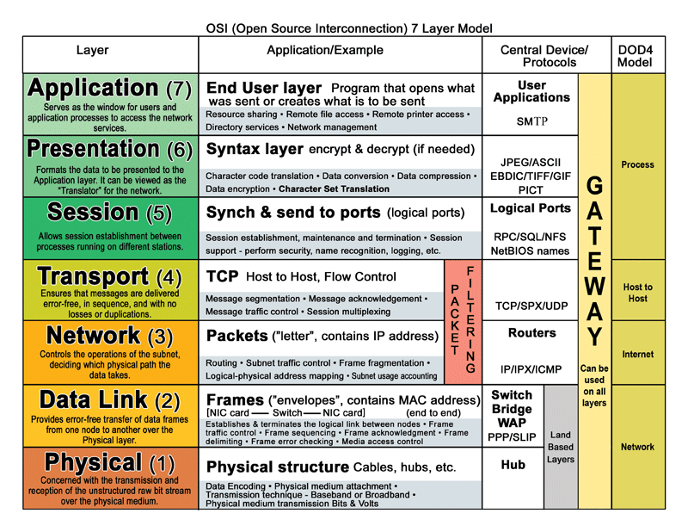
Network Communication Structure

Slide 10
Physical Network Structure
Again, so long as a medium can reliably transmit a byte stream between a source and a destination, it can function (in theory) as hardware. As a humorous example, IP over Avian Carriers has an official specification (RFC 1149).
Typically, in wired systems, a modem is used to translate a given byte stream into an electrical signal, which is transmitted across the wire. Transfer rates are limited by the bandwidth of the wire.
Routers are special servers that forward network packets between smaller sub-networks. Their only responsibility is to direct a byte stream to the requested destination.

Slide 11
Link Layer
The Link Layer is the set of all computers that are connected to each other for which networked communication does not require a router.
Transmitting data through the Link Layer is controlled by device drivers on the individual machines, firmware, and specialized chipsets (e.g., those in modems/WiFi antennae).
Link Layer addressing typically uses Media Access Control (MAC) addressing.

Slide 12
IP Addresses
An IP address is a unique address that's assigned to every device connected to the Internet.
Stands for Internet Protocol Address.
Assigned by IANA.
There are various types of IP addresses. These include public, private, shared, and dedicated.
Public IPs can be further broken down into dynamic (used by DHCP) and static (used by DNS). These IPs are also assigned by your ISP.

Slide 13
Public IP
Dynamic IP addresses are useful in receiving content on your device from the internet. More secure than static.
Static IP addresses are used by DNS servers to help you connect to websites on your device. Static IPs provide information such as ISP and location. Less secure than dynamic because static IPs don't change making them easier to track.

Slide 14
Private, Shared, and Dedicated IP
A private IP address is an internal address to your device. Typically used for business/corporate networks to create a secure private line of communication which can only be accessed from within one private network. Cannot be used for the Internet.
A shared IP address is used to cut costs for low-traffic websites. They're able to share 1 IP for multiple domains since none of them will be overloaded with traffic.
A dedicated IP address is used by a single company or individual. Allows access to a website by FTP using an IP address instead of domain name.

Slide 15
Steps to Internet Connection
Your device directly requests your Internet Service Provider.
Your ISP gives your device a unique IP address.
Your ISP grants access to the web.
Internet activity is routed through your ISP back to you using your IP address.

Slide 16
IPv4
Internet Protocol version 4 or IPv4 generates an address consisting of 4 8-bit numbers separated by periods. (0-255.0-255.0-255.0-255 in decimal form)
A full IPv4 address is 32 bits long, therefore IPv4 can assigned 2^32 or 4,294,967,296 unique addresses.

Slide 17
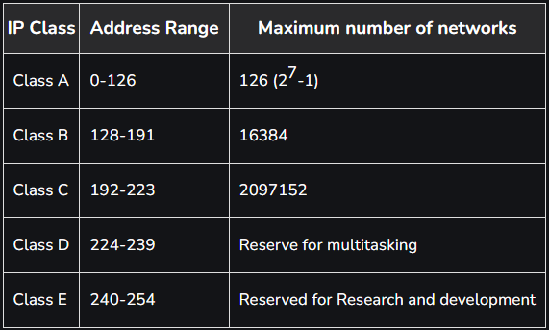
IPv4 Classes
Since there are 4.3 billion IPv4 addresses, we need a management scheme
There are 5 IPv4 Classes A-E.
Loopback addresses reserve the 127 (first bit) and allow for transmitting and receiving data packets, essentially for local development.

Slide 18
IPv6
Since IPv4 can only assign 4.3 billion unique addresses, we need more. Remember that every single device in the world on the internet needs a unique IP.
Internet Protocol version 6 generates an address consisting of 8 16-bit numbers separated by colons.
For humans, IPv6 is written and read in hexadecimal instead of decimal like IPv4.

Slide 19
Key Differences of IPv4 & IPv6
32-bit vs 128-bit length
IPv6 is more secure with built in encryption and authentication, as well as the IPSEC security feature.
Overall, IPv6 is the future and outperforms IPv4 in most regards.

Slide 20
DNS Protocol
Stands for "Domain Name System"
DNS client issues a DNS request providing a hostname i.e. "example.com"
The request is received by a DNS resolver.
The DNS resolver starts at the Internet's root DNS server, and works down to Top Level Domain DNS servers, then finally to the nameserver it's looking for.
Once the resolver finds the authoritative DNS name server, it returns the IP address to the client.
The request is now resolved, and the client connects directly via the IP address.

Slide 21
Domain Names & Tree Structure
"forum.support.example.com"
Hierarchy is exposed by reading right to left, each domain/node is separated by a period.
This is how the DNS resolver searches for an IP address given a domain name.

Slide 22
An Extremely Short History of DNS
In the 70s, SRI had a text file called hosts.txt, which contained all current hostnames to computer addresses for ARPANET.
In the 80s, it was understood that this approach would not scale. John Postel from USC delegated the task of creating an automatic system to his colleague Paul Mockapetris.
Paul ignored the 5 competing solutions he was told to follow, and he created his own: DNS.

Slide 23
Architecture of DNS Resolver and Name Server
To maximize efficiency, the DNS resolver follows an "algorithm" to resolve DNS requests as follows:
The resolver checks its local cache or operating system on the device for the resource record of the given domain name.
If that doesn't work, then it looks for a direct reference to the authoritative name server of the domains DNS zone (the name in the address).
If that doesn't work, the resolver reaches of the 13 DNS root servers and checks for a reference at the TLD i.e. (.com, .org, .net, etc.).

Slide 24
DHCP
Dynamic Host Configuration Protocol is a set of rules for assigning dynamic IP addresses to devices on a network.
The DHCP server has a pool of potential dynamic IP addresses both IPv4 and IPv6.
The server leases an address to a DHCP enabled client when they connect to a network.
When a client leaves the network and the address is no longer being used, it's stored back into the pool on the DHCP server to be reallocated.
Your public dynamic IP addresses assigned via DHCP are what allow your ISP to connect you to a website/application.

Slide 25

IP Packets
What are packets?
IPv4 vs IPv6
Packet Structure/assembly
Packet fragmentation
Packet Re-assembly?
Why are these even useful?
Packet loss : The plight of the modern gamer

Slide 26
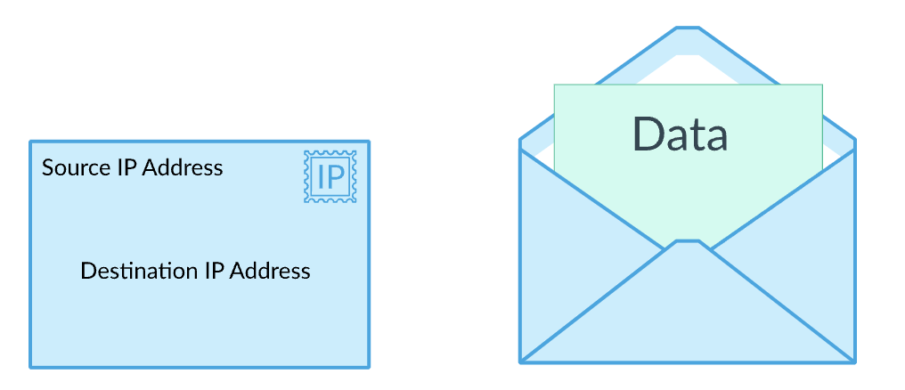
What are packets
Information is not sent as a constant stream though the internet, it travels in broken up blocks of data
These discrete segments of data are called "Packets"
The packets are assembled, sent as standalone information over the web and reassembled at the destination.
While not entirely accurate, it can be helpful to think of them similar to mail envelopes
Source : https://www.khanacademy.org/computing/computers-and-internet/xcae6f4a7ff015e7d:the-internet/xcae6f4a7ff015e7d:routing-with-redundancy/a/ip-packets

Slide 27
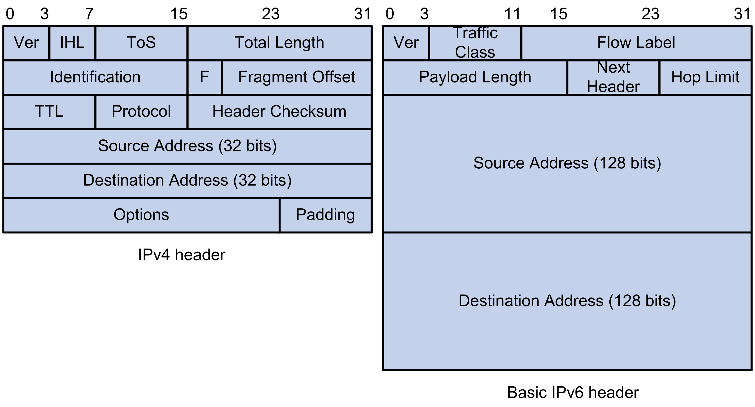
IPv4 vs IPv6
As discussed earlier main difference is size of information
- 32 bit (IPv4) vs 128 bit (IPv6)
- Address Space (header)
IPv6 packets will need to be fragmented if sent to an IPv4 router as they contain too much information
Source : https://techhub.hpe.com/eginfolib/networking/docs/switches/5120si/cg/5998-8491_l3-ip-svcs_cg/content/436042794.htm

Slide 28
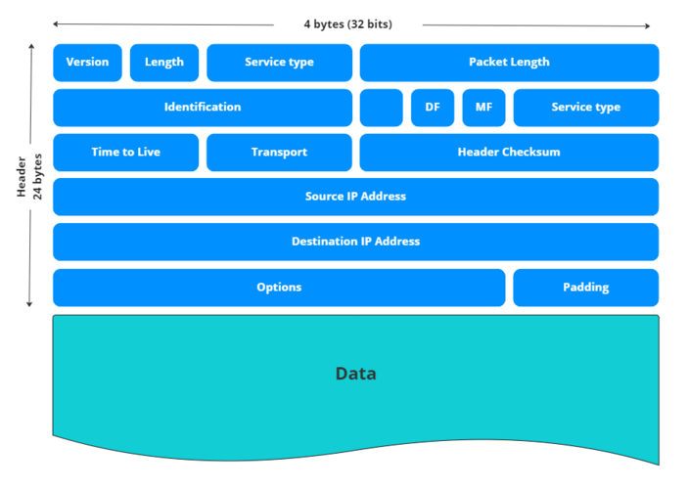
Packet Structure AKA Encapsulation
Packets generally consist of 3 major components
Header – max 24 bytes
Payload Some packets will carry a termination segment (not majority)
Termination segment on last packet
4 bytes (32 bit) width – IPv4
Source : https://www.civo.com/learn/ip-packets

Slide 29
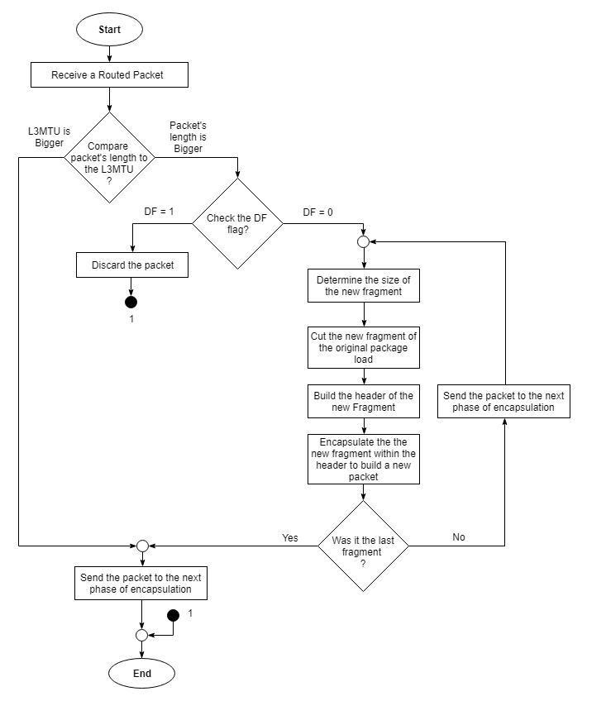
Flow chart of how a packet may be processed upon reception - DF = Discard Flag : If set to 1, the packet may be discarded - MTU = Maximum Transmission Unit - Following page includes further fragmentation example
Source : Michel Bakni - Own work, CC BY-SA 4.0, https://commons.wikimedia.org/w/index.php?curid=70675763

Slide 30
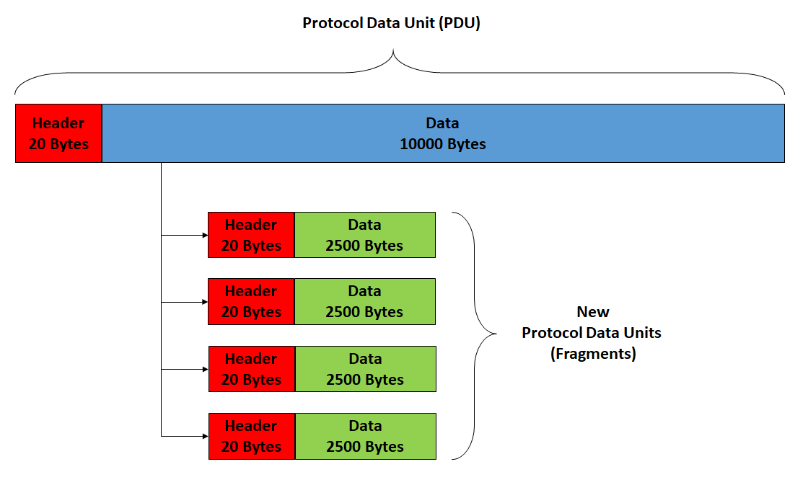
Packet Fragmentation
Source : Michel Bakni - Own work, CC BY-SA 4.0, https://commons.wikimedia.org/w/index.php?curid=70675763

Slide 31
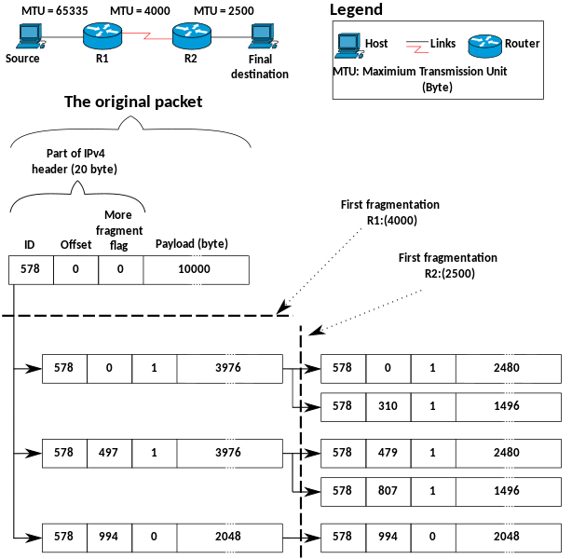
2-layer Fragmentation
Router #1 MTU is 4000
Router #2 MTU is 2500
Original Payload is 10,000 bytes and must be broken down to the MTU accepted by R1 and then again for R2
Source : Michel Bakni - Own work, CC BY-SA 4.0, https://commons.wikimedia.org/wiki/File:IPv4_Fragmentation_example_-en.svg

Slide 32

Packet Reassembly
Reassembly can only be performed at the destination as not all packets will follow the same path
When packets are fragmented, they are given their own header information to be reassembled at the destination
Sequence Numbers, Offset fields, Fragment flags, ID, etc. are all used to properly order packets
Path MTU Discovery is used by operating systems to determine the lowest MTU on the path and send packets at that length to avoid fragmentation

Slide 33
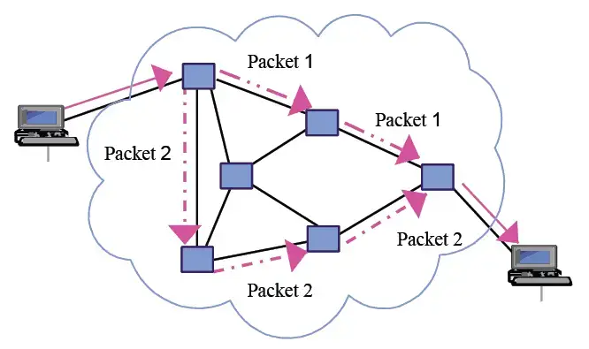
Advantages of packets
Redundancy !!!
- If a packet is lost, it can be requested without having to re-send the rest of the surrounding data
Path of least resistance
- Packets will be sent along the best path
Speed
- Packets travel concurrently, slowdowns in certain areas do not affect the overall data stream
Source : https://networkencyclopedia.com/packet-switching/

Slide 34

Packet Loss
Most noticeable in online games where reaction time is critical – FPS games
Some data packets are lost in transmission
- This is usually not an issue for most aspects of the internet, unless at a substantial scale. Very noticeable in FPS games
Cause of “Rubber-Banding” – Packets on player position are not getting received and the rubber banding effect is the server trying to quickly relocate the player.
Erratic game behavior

Slide 35
TCP
What is TCP
TCP: stands for Transmission Control Protocol
Reliable and connection based protocol
Operates on the transport layer on TCP/IP model
Widely used on the internet

Slide 36
TCP Handshaking
What is TCP Handshaking?
a three-step procedure used to establish a reliable connection
Steps:
Sender initiates the connection with a SYN packet
Receiver responds with a SYN-ACK packet
Sender acknowledges with an ACK packet

Slide 37
TCP
TCP Key features & Characteristics
Three-way handshake for connection establishment
Reliability through error detection, retransmission, and in-order delivery
Ordered delivery of data packets using sequence numbers
Flow control mechanisms for optimal transmission

Slide 38
Windowing and flow control
TCP utilizes windowing and flow control mechanisms to optimize data transmission and prevent overwhelming the receiver or the network.
Sliding window mechanism for optimizing data transmission
Receiver advertises its available buffer space (window size)
Sender adjusts transmission rate based on the receiver's window size
Flow control prevents overwhelming the receiver or the network

Slide 39
Keep Alive
What is Keep Alive? Keep Alive in TCP is a mechanism used to ensure the liveliness and maintain the active state of a TCP connection.
How it works :
Purpose of Keep Alive
Sender periodically sends small packets to the receiver
No response within a timeout period
Connection considered inactive if no response received
Actions taken based on Keep Alive results

Slide 40
UDP
What is UDP
UDP: stands for User Datagram Protocol
connectionless protocol
Operates on the transport layer on TCP/IP model
does not establish a connection before transmitting data and does not provide built-in reliability mechanisms

Slide 41
UDP
UDP Key features & Characteristics
No connection establishment; each packet is treated independently
Lack of built-in reliability mechanisms; packets may be lost or arrive out of order
No flow control mechanisms; sender can transmit at its own rate
Suitable for applications prioritizing speed and low latency over reliability

Slide 42
Use Case For TCP & UDP
UDP Examples
Real-Time Multimedia Streaming
Online Gaming
VoIP (Voice over IP)
TCP Examples
Web Browsing
Email
File Transfer
Real-Time Streaming

Slide 43
TCP/IP/Ethernet Layered Network Communication Structure
Ethernet belongs to the Data Link layer.
IP belongs to the Network layer.
TCP belongs to the Transport layer.
Simplified steps:
Ethernet creates frames.
IP routes from one endpoint to another.
TCP delivers the frames.

Slide 44
Ports
Ports are used to direct the byte stream to particular Services a given machine offers.
Well-known Ports include:
DNS: 53
FTP: 20/21, 989/990 (TSL/SSL)
HTTP: 80, 443 (HTTPS Encrypted)
IMAP: 143, 993 (TSL/SSL)
POP: 109 (POP2), 110 (POP3)
SMTP: 25, 465 (SMTP over TLS/SSL)
SSH: 22

Slide 45
Encryption and Security: SSL/TLS
Overview:
Uses digital key-based algorithms to encrypt information before it is transferred over a network.
The algorithm used is negotiated by the Client and the Server.
Encryption keys are certified by Certificate Authorities, which are typically either private for-profit companies (e.g., IdenTrust, whose founding interests included a number of large multinational banks and is currently owned by HID Global) or non-profit organizations (E.g., Let’s Encrypt, whose founding interests included The Electronic Frontier Foundation, Mozilla, Google, Facebook, and the Bill and Melinda Gates Foundation and which is run by the Internet Security Research Group).

Slide 46
Encryption and Security: SSL/TLS
Development History:
In 1986/1987, the National Security Agency (NSA), National Bureau of Standards, Defense Communications Agency, and around a dozen large communication and computer corporations initiated the Secure Data Network Systems (SDNS) program.
In 1994, researchers at the Networking Research Laboratory at University of Texas, Austin, published a description of Secure Network Programming (SNP) API, intended to theoretically allow retro-fitting existing network applications with security features.

Slide 47
Encryption and Security: SSL/TLS
Development History:
Around this same time (1994/1995), Netscape develops the Secure Socket Layer (SSL) protocol for its browser. Early versions of the protocol are buggy and full of vulnerabilities.
1995’s SSL 2.0 is the first publicly released version, but was vulnerable to attacks such as Man-in-the-Middle. Also, it assumed single-service/fixed-domain certificates, which conflicts with already-popular virtual web hosting.
SSL 3.0 was implemented in 1996 to address these issues.
The OpenSSL project is founded in 1998 to provide free encryption tools. It is still active (most work is done by volunteers) and working on implementations for current TLS specifications

Slide 48
Encryption and Security: SSL/TLS
Development History:
In 1999, TLS 1.0 is defined in IEFT RFC 2246. This protocol is based on Netscape’s SSL protocol, but there were enough differences to prevent interoperability.
TLS 1.1 was defined in RFC 4346 in 2006. This improved resistance to some types of attacks and changed the way certain errors were handled.
In 2008, TLS 1.2 was defined to use superior encryption algorithms designed by the NSA.
2011’s RFC 6176 refines TLS and removes all backward-compatibility with SSL

Slide 49
Encryption and Security: SSL/TLS
Development History:
TLS 1.3 was defined in 2018 (RFC 8446). It removed support for weaker encryption algorithms and strengthened the security of negotiation/handshaking protocols. These changes resulted in some challenges for backward-compatibility with proxy servers, slowing its adoption.
TLS 1.0 and 1.1 were deprecated in RFC 8996 (2021)

Slide 50
Encryption and Security: SSL/TLS
Protocol Flow:
Client connects to the Server using TCP or UDP. Typically for encrypted HTTP connections, Clients attempt to connect to Server Port 443, rather than Port 80, which handles unencrypted traffic.
Client initiates a TLS handshake, sending the version of TLS that it supports and the set of cipher algorithms it is capable of using in plain text.
Server responds with its choice for TLS version and encryption algorithm and sends its certificate so that the Client can confirm the Server is who it says it is.

Slide 51
Encryption and Security: SSL/TLS
Protocol Flow:
If the Client is satisfied with the Server’s response, it initiates the encryption key exchange
The Server receives the Client message and checks its integrity by verifying the MAC, and returns an encrypted FINISH message to the Client
The Client decrypts the FINISH message, verifies its integrity, and begins using the connection for application communication (e.g., sending HTTP requests)

Slide 52
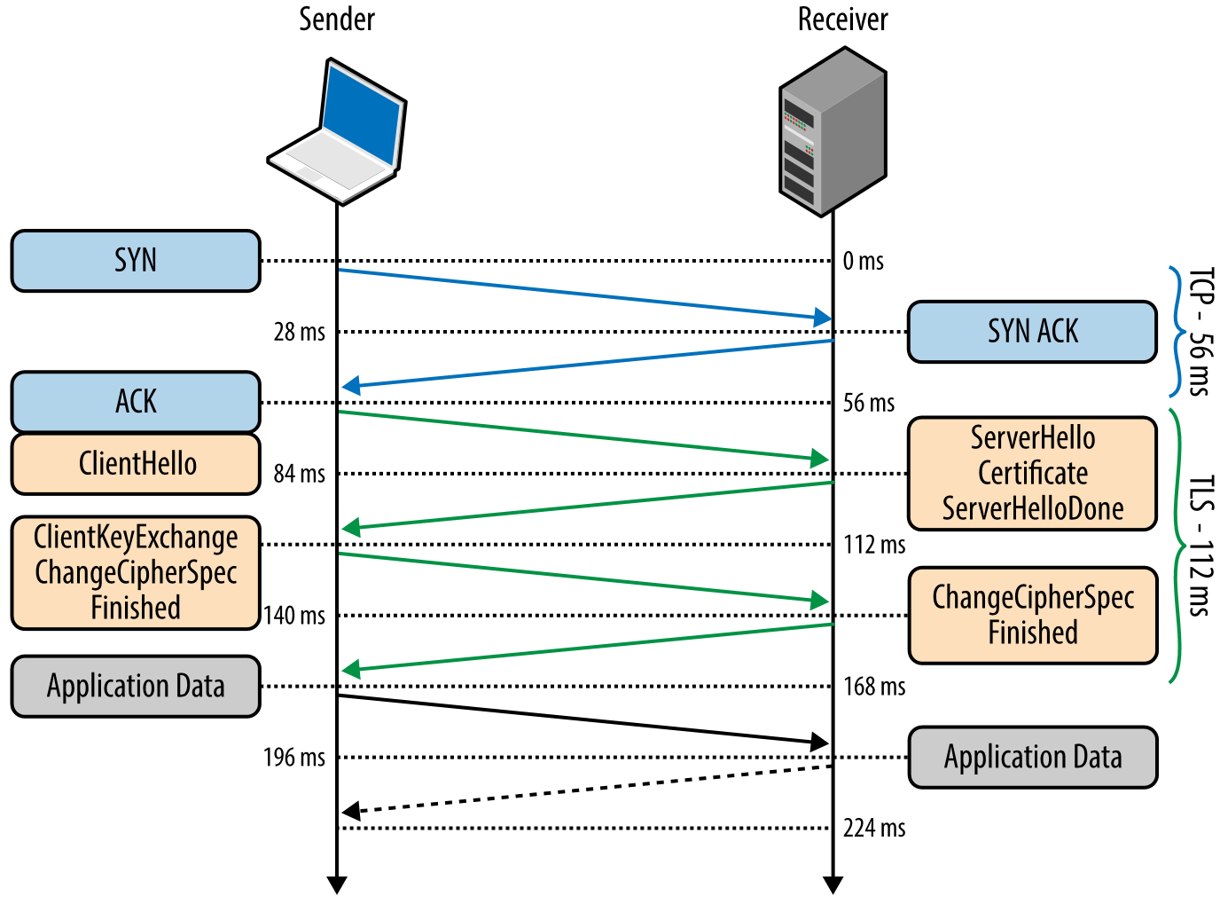
Encryption and Security: SSL/TLS Handshake

Slide 53
Mail Protocols: Multipurpose Internet Mail Extensions (MIME)
Development History
All mail protocols initially supported only plain-text (7-bit ASCII).
MIME was developed at Carnegie Mellon University as a way to indicate the structure of data-types in the body of a message so that they could be interpreted correctly by the recipient.
The MIME Content-Header allowed for the creation of a tree-structure for the body of the message.
Content types include “application”/”audio”/ ”image”/”message”/”multipart”/”text”/”video”
Subtypes (e.g., “jpg”, “mp3”) are also declared.
Although originally developed for use with SMTP, MIME has also been useful for HTTP and other text-based data transfer protocols.

Slide 54
Hypertext Transfer Protocol (HTTP and HTTPS)
Overview
Designed for the transfer of [originally text-based] data using the Client–Server networking model.
Data Transfers follow a Request–Response pattern over a Single Duplex connection:
The Client initiates the transfer by requesting a resource to a server through a well-known port (usually 80 for unencrypted connections or 443 for encrypted connections).
If the Server is listening on the appropriate port, it will accept the request and send the requested resource
As the name of the protocol implies, data is generally formatted using Hypertext Mark-up Language (HTML).
HTTP URIs are unencrypted, while HTTPS URIs use TLS 1.2+ encryption to protect data during transfer.

Slide 55
Hypertext Transfer Protocol (HTTP and HTTPS)
Development History and Standard Specifications
Development initiated by Tim Berners-Lee at CERN in 1989, along with HTML and the Web Browser [Client]–Web Server paradigm.
The first Web Server using this protocol went live in 1990. The protocol only had one associated method, GET, which the Client used to request resources from the server. Server Response was always an HTML document. Under this paradigm, the connection would be dropped after each completed transfer of data from the server and would need to be re-established to make additional requests.
The first protocol standard definition document [HTTP/0.9] was published in 1991 and was 700 words long.

Slide 56
Hypertext Transfer Protocol (HTTP and HTTPS)
Development History and Standard Specifications
HTTP/1.0 was finalized in May 1996 as RFC 1945, authored by Berners-Lee, Fielding, and Frystyk for the W3C. However, HTTP/1.1 was already being drafted and many web browsers were implementing new suggested features.
HTTP/1.1 was finalized in 1997 as RFC 2068. This standard allowed for Virtual Hosting (so that a single server pool could host multiple domains) and keep-alive connections that allowed Clients to request multiple resources from the same server without requiring them to renegotiate the connection.
HTTP/1.1 was revised and updated as RFC 2616 in 1999

Slide 57
Hypertext Transfer Protocol (HTTP and HTTPS)
Development History and Standard Specifications
The W3C HTTP Working Group passed responsibility for HTTP Standards development to IETF in 1999.
IETF initiated an HTTP Working Group in 2007 to revise HTTP/1.1 and develop future HTTP standards.
In 2009, Google released its HTTP binary (general data, not necessarily text) protocol, dubbed SPDY, which provided significant speed improvements over HTTP/1.1. This ”standard” was implemented first by Google’s own browser, and many other browsers followed suit.

Slide 58
Hypertext Transfer Protocol (HTTP and HTTPS)
Development History and Standard Specifications
In 2014, the IETF Working Group finalized its revision of the HTTP/1.1 standard in a set of six RFCs:
RFC 7230: Message Syntax and Routing [Officially Deprecated HTTP/0.9]
RFC 7231: Semantics and Content
RFC 7232: Conditional Requests
RFC 7233: Range Requests
RFC 7234: Caching
RFC 7235: Authentication
In 2015, the IETF Working Group released its HTTP/2.0 specification as RFC 7540, which was derived primarily from Google’s SPDY protocol. In particular, it allowed for multiplexed sessions across a single TLS/TCP connection which enabled more efficient header compression and concurrent messaging between Client and Server. This standard was not intended to obsolete or supersede HTTP/1.1, but rather to complement/extend it.

Slide 59
Recent Developments: HTTP/3
Drafts of HTTP/3 were first published in 2020.
IETF has released its first official HTTP/3 standard definition as RFC 9114 as one of seven RFCs that refactor and define official HTTP/1.1, HTTP/2, and HTTP/3 standards.
Rather than using TCP, HTTP/3 uses QUIC and UDP Transport-Layer Protocols to establish a secure, multiplexed connection between Client and Server. This change in transport-layer protocols was made in order to reduce head-of-line blocking issues, allowing for better data transfer.

Slide 60
HTTP Method Properties
HTTP Methods are classified using three properties:
Safe: These methods do not directly have an effect on the server; i.e., they are “read-only”, though the server may write information to a log-file or perform other actions when they receive these requests, depending on how the server is configured.
Idempotent: Multiple identical requests have the same effect as a single request. All Safe methods are Idempotent, since Safe methods are defined as having no effect.
Cacheable: Methods are cacheable if the responses can be saved and reused.

Slide 61
HTTP Methods
GET (S, I, C): Requests that the targeted resource (e.g., an html file) send a representation of its state to the Client (e.g., send a copy of itself). IMPLEMENTATION REQUIRED
HEAD (S, I, C): Requests the Header/Meta-data portion on a resource’s state only (i.e., no body/data). IMPLEMENTATION REQUIRED
POST (C): Sends data to the server and requests that the server process the data according to the semantics of the target resource (e.g., allows for posting messages to forums, online shopping, etc.)
PUT (I): Sends a resource to the server and requests that the server create a copy of the resource or update that resource’s state if it already exists at a location specified by the Client.

Slide 62
HTTP Methods
DELETE (I): Requests that the Server delete a resource if it exists.
CONNECT: Requests that an intermediary server establish a TCP/IP tunnel to an origin server. Used for creating HTTP proxies with TLS
OPTIONS (S, I): Requests the list of Methods that the target resource supports.
TRACE (S, I): Requests a copy of the request itself be returned by the Server as the response body. This can be used to check for modifications made by intermediaries.
PATCH: Requests a partial modification of a resource on the Server

Slide 63
HTTP Request Syntax
Request Line:
METHOD resource_url PROTOCOL VERSION
Header Fields
Host: domain_string [Required by HTTP/1.1+]
Optional Fields (e.g., Accept [media type], Accept-Charset, Authorization, Cookie, User-Agent [client information], etc.)
Body [If Allowed/Required by the Method]

Slide 64
HTTP Response Syntax
Status Line
HTTP/VERSION 3_digit_status_code Reason
Response Header Fields [Optional]
E.g., Content-Encoding, Content-Type (MIME), Set-Cookie, etc.
Message Body [Optional]

Slide 65
HTTP Server Status Codes
1XX: Informational Codes
E.g., 100 Continue: Server has received the Request Headers and the Client should send the Request Body
2XX: Request Successful
E.g., 200 OK
3XX: Redirect
E.g., 301 Moved Permanently
4XX: Client Errors
E.g., 400 Bad Request, 403 [Access] Forbidden, 404 Not Found, 405 Method Not Allowed
5XX: Server Errors
E.g., 503 Service Unavailable (server overloaded or down for maintenance), 505 HTTP Version Not Supported

Slide 66
File Transfer Protocol (FTP)
Overview
Designed to transfer a broad range of computer files over a network using a Client–Server architecture.
Can transfer both text-type files (ASCII, EBCDIC, and some implementations also support Unicode) and general file-types (files transferred as an unencrypted bytestream)
Unlike HTTP, uses two simplex connections (one for control messages, one for data), instead of one duplex connection

Slide 67
File Transfer Protocol (FTP)
Development History
In 1971, the original specification, published as RFC 114, was written by Abhay Bhushan, an Indian computer scientist who also contributed to the development of TCP/IP and early e-mail protocols
As such, FTP was designed before TCP/IP existed, and was designed for an earlier transport protocol, Network Control Protocol (NCP), which only allowed for simplex (one-way) connections.
When TCP/IP was implemented in the 1980s, FTP was updated to use the new protocol (RFC 765), but its simplex design was maintained to allow backward-compatibility.
The current official standard version of the protocol is RFC 959 (1985), though several later RFCs have proposed extensions for security, firewall compatibility, and IPv6 support.

Slide 68
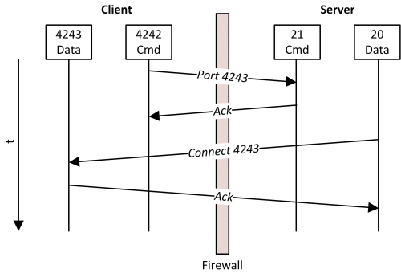
Active FTP (the Original Specification)

Slide 69
Active FTP: Problems
Firewalls typically can’t handle Active FTP: the ports the Client uses for the connections are randomly assigned, so firewalls cannot be configured to allow connections into those ports in advance.
Clients behind Network Address Translators like routers do not necessarily know the public IP address and port of the NAT, so cannot themselves transmit that information.

Slide 70
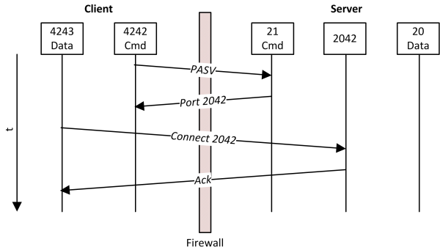
Alternative Approach: Passive FTP

Slide 71
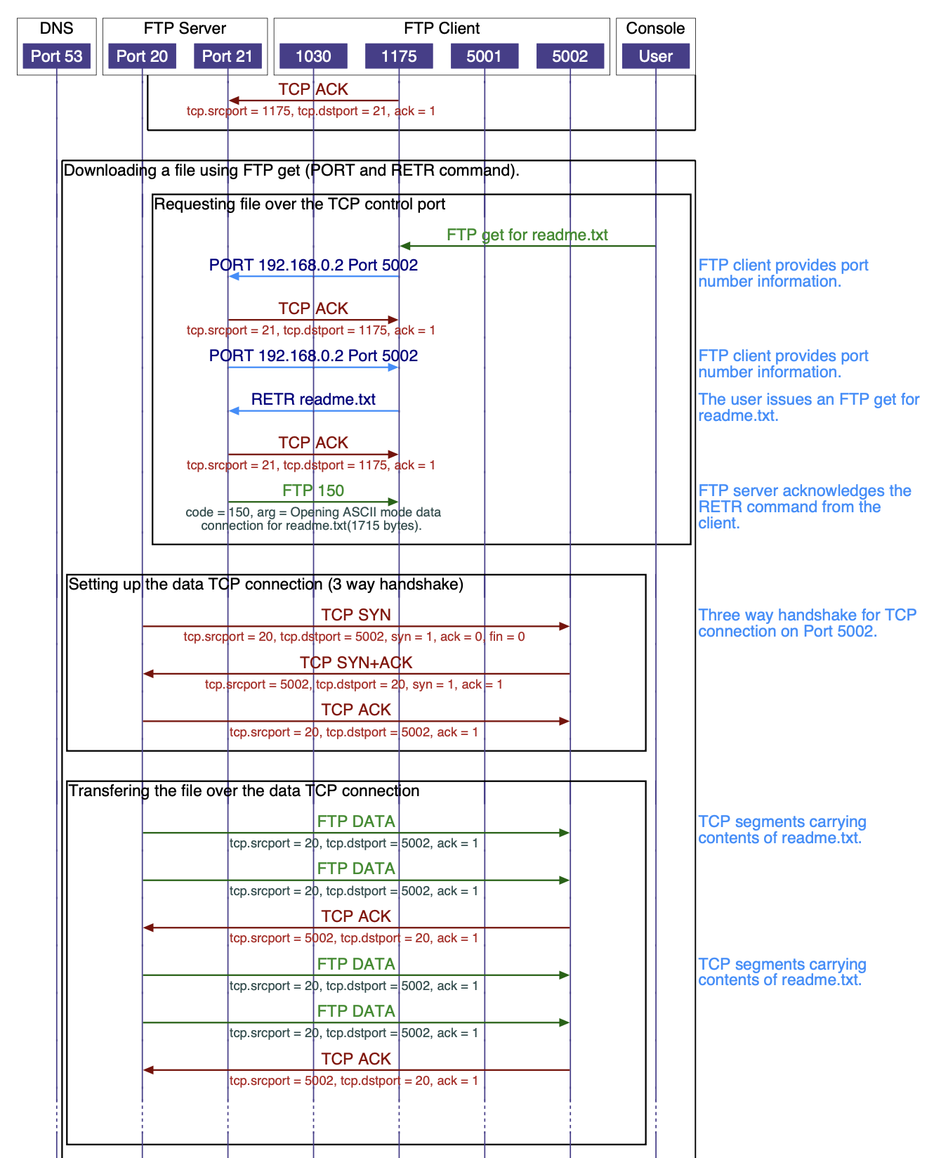
FTP Session Flow

Slide 72
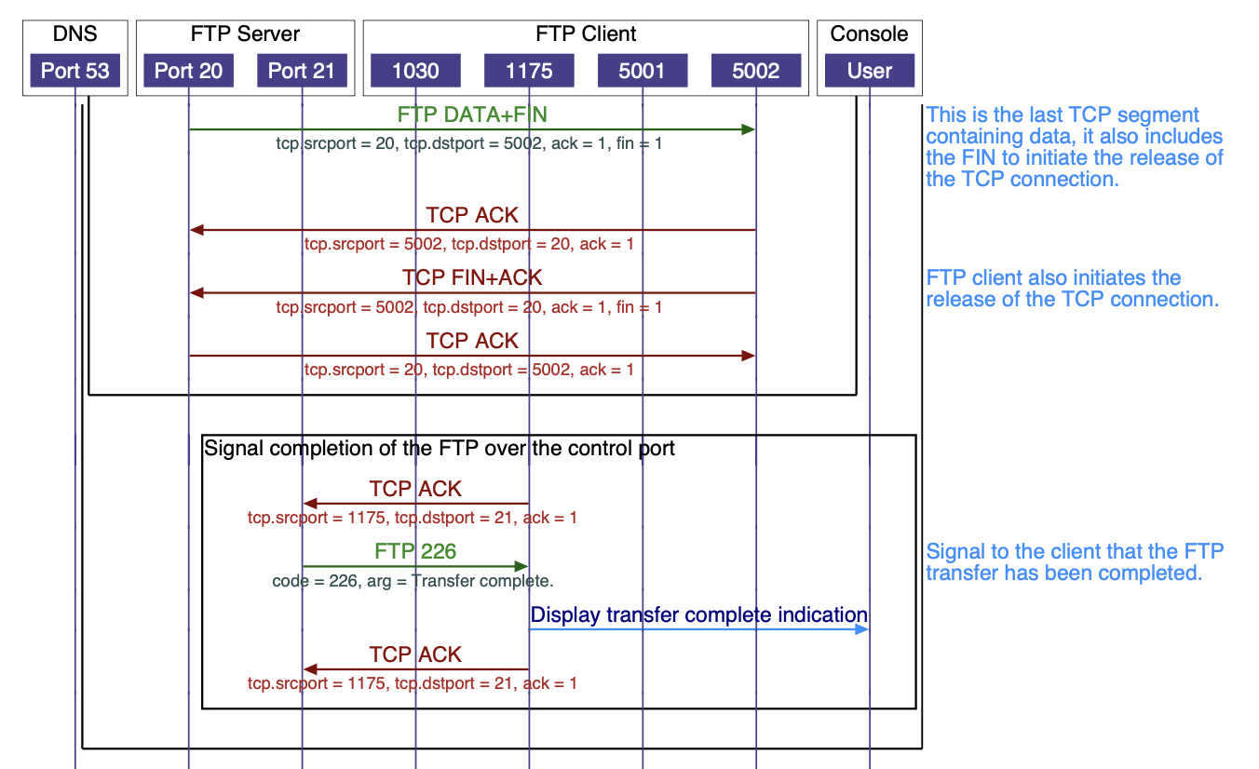
FTP Session Flow

Slide 73
FTP Security
FTP was not designed to be a secure protocol. Data and even authentication credentials are transmitted using unencrypted clear-text.
An RFC by Allman and Ostermann (1999) outlines a variety of security problems with the protocol including:
Bounce attacks using FTP proxy commands which allow a Client to ask an FTP server to send a file to another Server. According to the authors such attacks may allow activities such as forging emails, and DDoS attacks while making tracing difficult
Spoof attacks, which might allow outside agents to gain access to restricted files

Slide 74
FTP Security
Brute-force password guessing: FTP authentication does not “lock out” a potential Client after any number of failed attempts
Credential Scraping and Packet Capture: usernames and passwords are sent in clear text and can be intercepted, as can any unencrypted data
Port Stealing (it is for this reason that ports must be assigned randomly so that attackers can’t intercept a request and “guess” the port to steal the connection)

Slide 75
FTP Security: Solutions
FTPS: FTP using Transport Layer Security
Implicit Security: Requires the Client to initiate connection to the FTP server with a TLS ClientHello message, or the Server immediately drops the connection. This method is deprecated.
Explicit Security: Client explicitly requests encryption. Client and Server then negotiate encryption method. This Protocol was initially described in RFC 2228, and finalized in RFC 4217.
Not to be confused with SFTP, which uses Secure Shell (SSH) to provide Security

Slide 76
Mail Protocols: Precursors to Modern Protocols
Development History
MIT introduces its Compatible Time-Sharing System (CTSS) in 1961, allowing multiple users to log into a central system from remote terminals and transmit files using the central disk. Gradually messaging capabilities were implemented.
Also in the 1960’s, the US military’s AUTODIN network provided messaging between over 1000 terminals at over 300 different sites, processing an average of 30 million messages (average length: 3000 characters) per month.
In 1965, the MAIL method is added to CTSS

Slide 77
Mail Protocols: Precursors to Modern Protocols
Development History
In 1971, SNDMSG is implemented on ARPANET, allowing the first networked electronic mail. Addresses are of the format username@hostname. It becomes standardized by RFC 733 in 1977, with data transfer using FTP. In 1982, RFC 805 changes the address to username@host.domain
Unix Mail and APL Mailbox are developed in 1972
CompuServe begins offering electronic mail as part of their corporate networking services in 1978, launches dial-up service with electronic mail in 1979, and rebrands its product as ”EMAIL” in 1981. It files an application to trademark for the term in 1983, but rescinds the application in 1984.
Hewlett-Packard begins to sell HPMAIL in 1982, which for a time became the world’s largest-selling email system.

Slide 78
Mail Protocols: SMTP is Defined
Development History
Mail Transfer Protocol is proposed as a replacement for FTP in 1980 (RFC 772). By 1981, Mail-related RFCs do not mention FTP. Simple Mail Transfer Protocol (SMTP) is described in RFC 788 (1981) and updated in RFC 821 (1982)
Mail between computers connected by LANs becomes increasingly popular during the 1980s. Different companies offered proprietary services. Eventually, mail could be exchanged between networks that used the same proprietary software.
In 1983, MCI Mail is launched. In 1989, this product becomes the first commercial, publicly-available email system to use the Internet.

Slide 79
Mail Protocols: Other Mail Protocols
Development History
Post Office Protocol (POP) is developed in 1984
RFC 974 (1986) updates how mail is routed to support DNS
Internet Message Access Protocol (IMAP) is developed in 1988

Slide 80
Simple Mail Transfer Protocol
Overview:
Originally designed to support unencrypted 7-bit ASCII text only: no security at all: susceptible to spoofing, spamming, etc. All servers were configured as open mail relays, allowing anyone with network access to send mail.
Also, originally servers were conceived of as being internal to a host network, receiving messages from “outside” and relaying them to users hosted on the network and collecting mail sent by users on a network and sending it “outside”. However, as time went on, users wanted to be able to send mail from a particular account without being physically connected to a particular network.

Slide 81
Simple Mail Transfer Protocol
Overview:
Eventually, this led to the separation of Servers into Mail Submission Agents (MSA), that receive messages from individual users and forward them to Mail Transfer Agents (MTA), which use DNS to route the mail to the appropriate receiving MTA. This may involve intermediary MTAs on different servers. The destination MTA hands the message to a Mail Delivery Agent (MDA) that saves the message in the recipient’s mailbox.
John Gardiner Myers drafted the SMTP AUTH protocol in 1995 to allow for authentication of users before an SMTP server would accept mail.
The Multipurpose Internet Mail Extensions (MIME) standards were developed to allow for the transmission of binary (non-text) data.

Slide 82
Simple Mail Transfer Protocol
Protocol Flow:
Client/Sending MTA initiates a connection with the SMTP server, typically using TCP. If a Client is connecting to an MSA to initially send a message, authentication protocols occur.
Client/Sender MTA issues a MAIL command, followed by the return-path (“From”/”Reply-To”) information for the message. Server/Receiving MTA Acknowledges.
Client/Sender MTA issues a RCPT command, followed by recipient information. This command can be issued multiple times if a single message is being sent to multiple addresses. Server/Receiver MTA Acknowledges.
Client/Sender MTA issues a DATA command to signal it is ready to send the body of the message. Server/Receiver MTA Acknowledges.
Client/Sender MTA transmits message contents, and concludes with END-OF-DATA. Server/Receiver MTA either acknowledges or rejects the entire message. If there is a transient failure, Sender MTA will queue and retry transaction.

Slide 83
Mail Protocols: Post Office Protocol (POP)
Post Office Protocol is the first of two protocols used to retrieve messages from a mail server onto a Client’s system.
It was designed assuming intermittent connection to the network (e.g., dial-up).
As such, it is designed to collect all messages from the Server, download them onto the Client’s system, and then delete the messages from the Server. The Client can then read and manipulate the messages locally.
POP3 is the version of the protocol in most common use. Its most current specification is RFC 1939 (1996)

Slide 84
Mail Protocols: Post Office Protocol (POP)
Protocol Flow:
Client opens connection and Authentication/TLS is negotiated.
Server indicates if there are messages waiting to be delivered to the user (number and size of each)
The Client requests the receipt of each message and optionally requests that each message be deleted from the Server after it has been received.
After all messages have been received, Client initiates the end of the session.

Slide 85
Mail Protocols: Internet Message Access Protocol (IMAP)
The second (slightly younger) Mail delivery protocol. Unlike POP, it was designed to leave messages on the Server until deleted by default, which allows for multiple Clients/Devices to manage the same inbox.
It also has more features for organizing/filtering messages into folders/mailboxes, performing partial fetches of MIME-encoded messages, dynamic state monitoring and push notification from Server to Client, and Server-side search.
Because these features are almost all Server-side, IMAP Servers are more complex than POP Servers
Its current standard is defined in RFC 9051 (2021)

Slide 86
IMAP Session Example
S: * OK IMAP4rev1 Service Ready
C: a001 login mrc secret
S: a001 OK LOGIN completed
C: a002 select inbox S: * 18 EXISTS
S: * FLAGS (\Answered \Flagged \Deleted \Seen \Draft)
S: * 2 RECENT
S: * OK [UNSEEN 17] Message 17 is the first unseen message
S: * OK [UIDVALIDITY 3857529045] UIDs valid
S: a002 OK [READ-WRITE] SELECT completed
C: a003 fetch 12 full
S: * 12 FETCH (FLAGS (\Seen) INTERNALDATE "17-Jul-1996 02:44:25 -0700" RFC822.SIZE 4286 ENVELOPE ("Wed, 17 Jul 1996 02:23:25 -0700 (PDT)" "IMAP4rev1 WG mtg summary and minutes" (("Terry Gray" NIL "gray" "cac.washington.edu")) (("Terry Gray" NIL "gray" "cac.washington.edu")) (("Terry Gray" NIL "gray" "cac.washington.edu")) ((NIL NIL "imap" "cac.washington.edu")) ((NIL NIL "minutes" "CNRI.Reston.VA.US") ("John Klensin" NIL "KLENSIN" "MIT.EDU")) NIL NIL "<B27397-0100000@cac.washington.edu>") BODY ("TEXT" "PLAIN" ("CHARSET" "US-ASCII") NIL NIL "7BIT" 3028 92))

Slide 87
IMAP Session Example
S: a003 OK FETCH completed
C: a004 fetch 12 body[header]
S: * 12 FETCH (BODY[HEADER] {342}
S: Date: Wed, 17 Jul 1996 02:23:25 -0700 (PDT)
S: From: Terry Gray gray@cac.washington.edu
S: Subject: IMAP4rev1 WG mtg summary and minutes
S: To: imap@cac.washington.edu
S: cc: minutes@CNRI.Reston.VA.US, John Klensin KLENSIN@MIT.EDU
S: Message-Id: B27397-0100000@cac.washington.edu
S: MIME-Version: 1.0 S: Content-Type: TEXT/PLAIN; CHARSET=US-ASCII S: S: )
S: a004 OK FETCH completed
C: a005 store 12 +flags \deleted
S: * 12 FETCH (FLAGS (\Seen \Deleted))
S: a005 OK +FLAGS completed
C: a006 logout
S: * BYE IMAP4rev1 server terminating connection
S: a006 OK LOGOUT completed

Slide 88
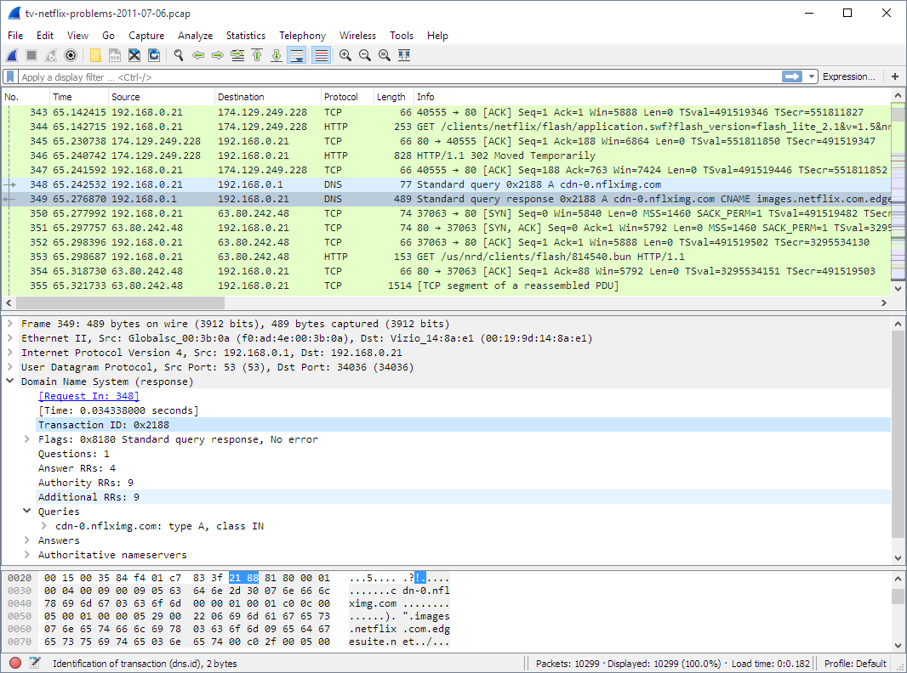

Wireshark: Overview
Wireshark is a free and open-source network protocol analyzer.
It is widely used for capturing and analyzing network traffic.
Wireshark allows you to inspect packets and understand network behavior.
Wireshark is available for Windows, macOS, and Linux operating systems.
It has both 32-bit and 64-bit versions depending on the platform.
Regular updates and new versions are released to enhance functionality and address security concerns.

Slide 89
Benefits for Network Analysis
Packet capture and analysis: Wireshark captures and decodes packets, providing deep insight into network communications.
Troubleshooting network issues: It helps diagnose and resolve problems like latency, packet loss, and protocol errors.
Security analysis: Wireshark aids in identifying potential security threats, intrusion attempts, and abnormal network behavior.
Protocol analysis: It assists in understanding the behavior and structure of various network protocols.

Slide 90

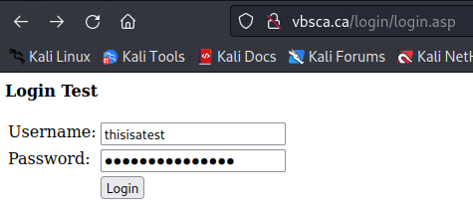
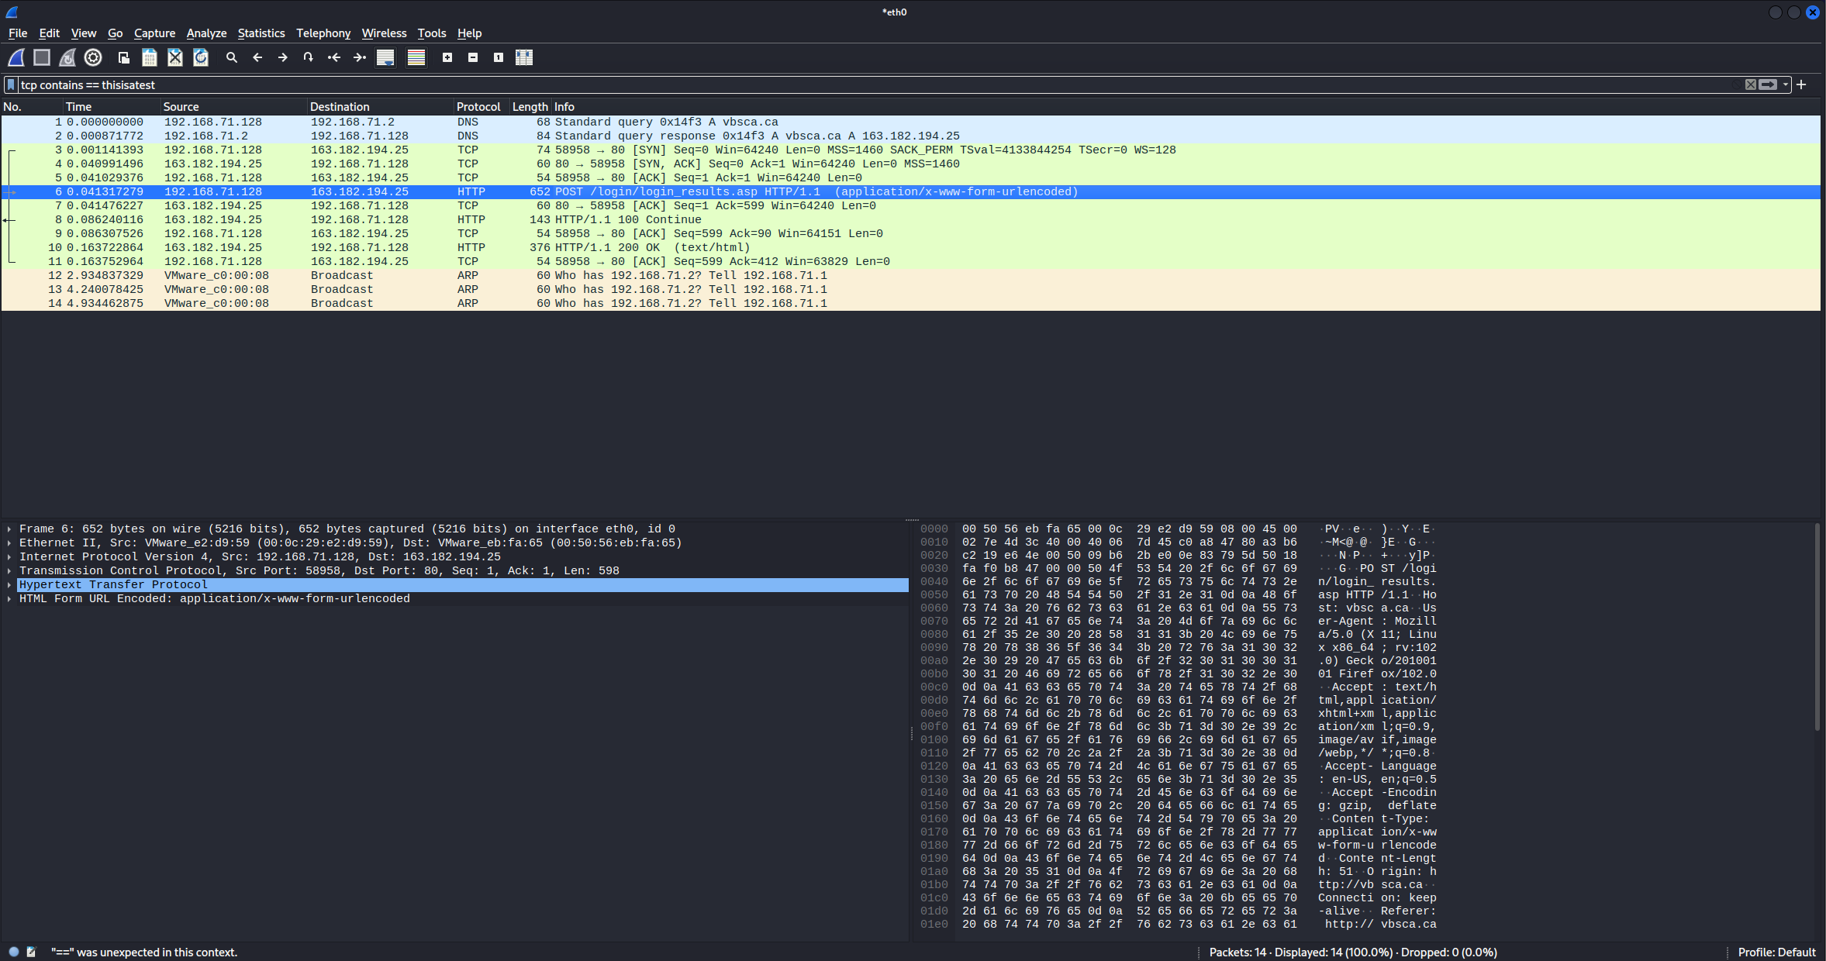
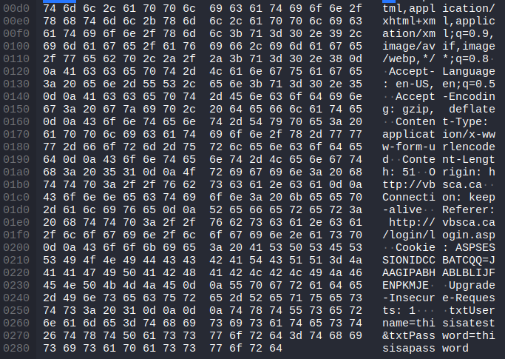

Importance of HTTP & HTTPS
Not Secure; HTTPS
thisisapassword

Slide 91
References
ARPANET. (2023, June 18). In Wikipedia. https://en.wikipedia.org/wiki/ARPANET
Berners-Lee, T., Fielding, R., Frystyk, H. (1996, May). RFC 1945: Hypertext transfer protocol – HTTP/1.0. Internet Engineering Task Force (IETF). https://datatracker.ietf.org/doc/html/rfc1945
Borenstein, N., Freed, N. (1993, September). RFC 1521: MIME (multipurpose internet mail extensions) part one: Mechanisms for specifying and describing the format of internet message bodies. Internet Engineering Task Force (IEFT). https://datatracker.ietf.org/doc/html/rfc1521
Certificate authority. (2023, June 26). In Wikipedia. https://en.wikipedia.org/wiki/Certificate_authority
Communications protocol. (2023, July 7). In Wikipedia. https://en.wikipedia.org/wiki/Communication_protocol
Computer network. (2023, July 7). In Wikipedia. https://en.wikipedia.org/wiki/Computer_network

Slide 92
Crispin, M. (2003, March). RFC 3501: Internet message access protocol – version 4rev1. Internet Engineering Task Force (IETF). https://datatracker.ietf.org/doc/html/rfc3501
Dierks, T., Allen, C. (1999, January). RFC 2246: The TLS protocol: Version 1.0. Internet Engineering Task Force (IETF). https://datatracker.ietf.org/doc/html/rfc2246
Fielding, R. (Ed.), Nottingham, M. (Ed.), Reschke, J. (Ed.). (2022, June). RFC 9110: HTTP semantics. Internet Engineering Task Force (IETF). https://datatracker.ietf.org/doc/html/rfc9110
File transfer protocol. (2023, July 6). In Wikipedia. https://en.wikipedia.org/wiki/File_Transfer_Protocol
Firewall (computing). (2023, May 31). In Wikipedia. https://en.wikipedia.org/wiki/Firewall_(computing)
FTPS. (2023, May 7). In Wikipedia. https://en.wikipedia.org/wiki/FTPS
FTP Server. (Accessed: 2023, July 9). Beckhoff. https://infosys.beckhoff.com/english.php?content=../content/1033/cx8180_hw/68233610358735665675.html&id=
FTP Session Sequences Diagram. (2013). EventHelix.com. https://www.eventhelix.com/networking/ftp/Ftp.pdf

Slide 93
Grigorik, I. (2013). Transport layer security. High performance browser networking. O’Reilly. https://hpbn.co/transport-layer-security-tls/
HID Global. (2023, April 17). In Wikipedia. https://en.wikipedia.org/wiki/HID_Global
History of email. (2023, June 26). In Wikipedia. https://en.wikipedia.org/wiki/History_of_email
HTTP. (2023, June 23). In Wikipedia. https://en.wikipedia.org/wiki/HTTP
HTTP/2. (2023, June 19). In Wikipedia. https://en.wikipedia.org/wiki/HTTP/2
HTTP/3. (2023, June 15). In Wikipedia. https://en.wikipedia.org/wiki/HTTP/3
IdenTrust. (2023, February 17). In Wikipedia. https://en.wikipedia.org/wiki/IdenTrust
Internet message access protocol. (2023, July 5). In Wikipedia. https://en.wikipedia.org/wiki/Internet_Message_Access_Protocol
Internet protocol suite. (2023, July 8). In Wikipedia. https://en.wikipedia.org/wiki/Internet_protocol_suite
Krasic, C., Bishop, M., Frindell, A. (Ed.). (2022, June). RFC 9204:
Let’s Encrypt. (2023, May 26). In Wikipedia. https://en.wikipedia.org/wiki/Let%27s_Encrypt
List of FTP commands. (2022, June 8). In Wikipedia. https://en.wikipedia.org/wiki/List_of_FTP_commands

Slide 94
List of HTTP header fields. (2023, June 18). In Wikipedia. https://en.wikipedia.org/wiki/List_of_HTTP_header_fields
List of HTTP status codes. (2023, July 9). In Wikipedia. https://en.wikipedia.org/wiki/List_of_HTTP_status_codes
List of TCP and UDP port numbers. (2023, July 7). In Wikipedia. https://en.wikipedia.org/wiki/List_of_TCP_and_UDP_port_numbers#Well-known_ports
MAC address. (2023, June 29). In Wikipedia. https://en.wikipedia.org/wiki/MAC_address
Melnikov, A. (Ed.), Leiba, B. (Ed.). (2021, August). RFC 9501: Internet message access protocol (IMAP) – version 4rev2. Internet Engineering Task Force (IETF). https://datatracker.ietf.org/doc/html/rfc9051
MIME. (2023, June 2). In Wikipedia. https://en.wikipedia.org/wiki/MIME
MKS075. (2023, February 21). Differences between secure socket layer (SSL) and transport layer security (TLS). Geeks for Geeks. https://www.geeksforgeeks.org/difference-between-secure-socket-layer-ssl-and-transport-layer-security-tls/

Slide 95
Myers, J., Rose, M. (1996, May). RFC 1939: Post office protocol – version 3. Internet Engineering Task Force (IETF). https://datatracker.ietf.org/doc/html/rfc1939
Network control protocol (ARPANET). (2023, March 19). In Wikipedia. https://en.wikipedia.org/wiki/Network_Control_Protocol_(ARPANET)
OpenSSL. (2023, June 29). In Wikipedia. https://en.wikipedia.org/wiki/OpenSSL
Port (computer networking). (2023, June 13). In Wikipedia. https://en.wikipedia.org/wiki/Port_(computer_networking)
Post office protocol. (2023, July 2). In Wikipedia. https://en.wikipedia.org/wiki/Post_Office_Protocol
Public key certificate. (2023, July 3). In Wikipedia. https://en.wikipedia.org/wiki/Public_key_certificate
QUIC. (2023, July 4). In Wikipedia. https://en.wikipedia.org/wiki/QUIC
Rutkowski, A. (2019, January 24). Creating TLS: The pioneering role of Ruth Nelson. CircleID. https://circleid.com/posts/20190124_creating_tls_the_pioneering_role_of_ruth_nelson
SakshiBhakhra. (2023, July 4). Secure socket layer (SSL). Geeks for Geeks. https://www.geeksforgeeks.org/secure-socket-layer-ssl/

Slide 96
Secure network programming. (2023, May 10). In Wikipedia. https://en.wikipedia.org/wiki/Secure_Network_Programming
shivani7081. (2022, February 14). Transport layer security (TLS). Geeks for Geeks. https://www.geeksforgeeks.org/transport-layer-security-tls/
Simple mail transfer protocol. (2023, June 25). In Wikipedia. https://en.wikipedia.org/wiki/Simple_Mail_Transfer_Protocol
SMTP Authentication. (2023, March 29). In Wikipedia. https://en.wikipedia.org/wiki/SMTP_Authentication
Transmission control protocol. (2023, June 11). In Wikipedia. https://en.wikipedia.org/wiki/Transmission_Control_Protocol
Transport layer security. (2023, July 5). In Wikipedia. https://en.wikipedia.org/wiki/Transport_Layer_Security
User datagram protocol. (2023, May 8). In Wikipedia. https://en.wikipedia.org/wiki/User_Datagram_Protocol
Virtual Hosting. (2023, July 4). In Wikipedia. https://en.wikipedia.org/wiki/Virtual_hosting

Slide 97
Wireshark. (2023). https://www.wireshark.org/
Zito, P. (2013, May 3). What is the OSI Model. Smart Buildings Academy. https://blog.smartbuildingsacademy.com/what-is-the-osi-model
Keshadi. (2023, April 13). What is an IP address?. GeeksforGeeks. https://www.geeksforgeeks.org/what-is-an-ip-address/
B, S. (2023, May 4). Differences between IPv4 and IPv6. GeeksforGeeks. https://www.geeksforgeeks.org/differences-between-ipv4-and-ipv6/
Gerend, J. (2021, July 29). Dynamic Host Configuration Protocol (DHCP). Microsoft Learn. https://learn.microsoft.com/en-us/windows-server/networking/technologies/dhcp/dhcp-top
NS1 – Intelligent DNS and Traffic Management. (2023). DNS protocol. NS1. https://ns1.com/resources/dns-protocol
NS1 – Intelligent DNS and Traffic Management. (2023b). DNS zones explained. NS1. https://ns1.com/resources/dns-zones-explained
II, J. B. (2022, April 18). What is ethernet?. Network World. https://www.networkworld.com/article/3657734/what-is-ethernet.html
Meridian Outpost. (2023). 5 Classes of IPv4 Addresses [Class A, B, C, D and E]. Www.meridianoutpost.com. https://www.meridianoutpost.com/resources/articles/IP-classes.php
‌

